Slide 1

My achievement
Yassine Bibi 5A&D

Slide 2
What did I achieve
When did I achieve it
How I won
What was my reaction
Where it happend
What others thought about it

Slide 3



What did I achieve
First victory royale
= Win
Fortnite
Battle Royale

Slide 4

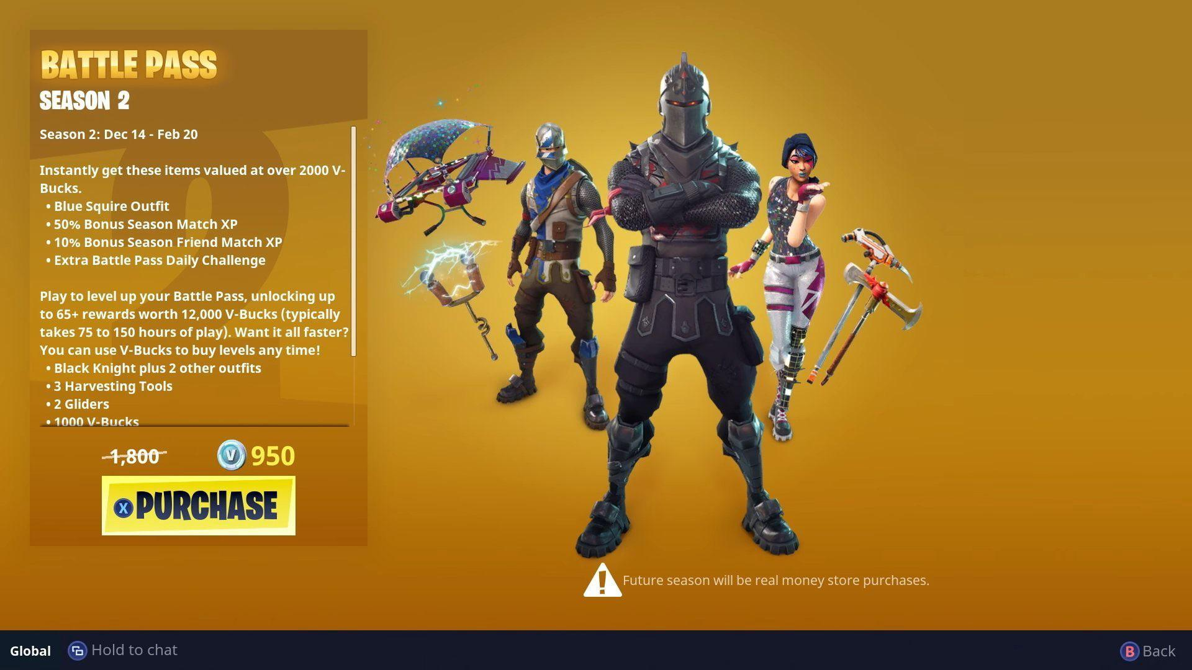
When did I achieve it
Season 2, Chapter 1
10 years old
2018
Solo game

Slide 5
How I won
Highground
Gold Scar, Purple Shotgun, Scoped Rifle
5 kills
Shot him from above

Slide 6
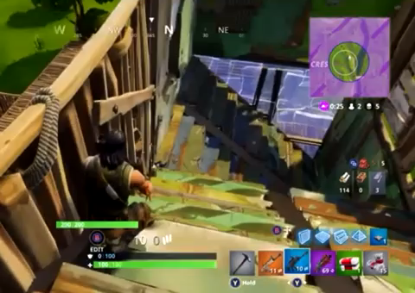

Slide 7

What was my reaction
Happy
Shaking
Dancing
Told my friends
Screaming

Slide 8
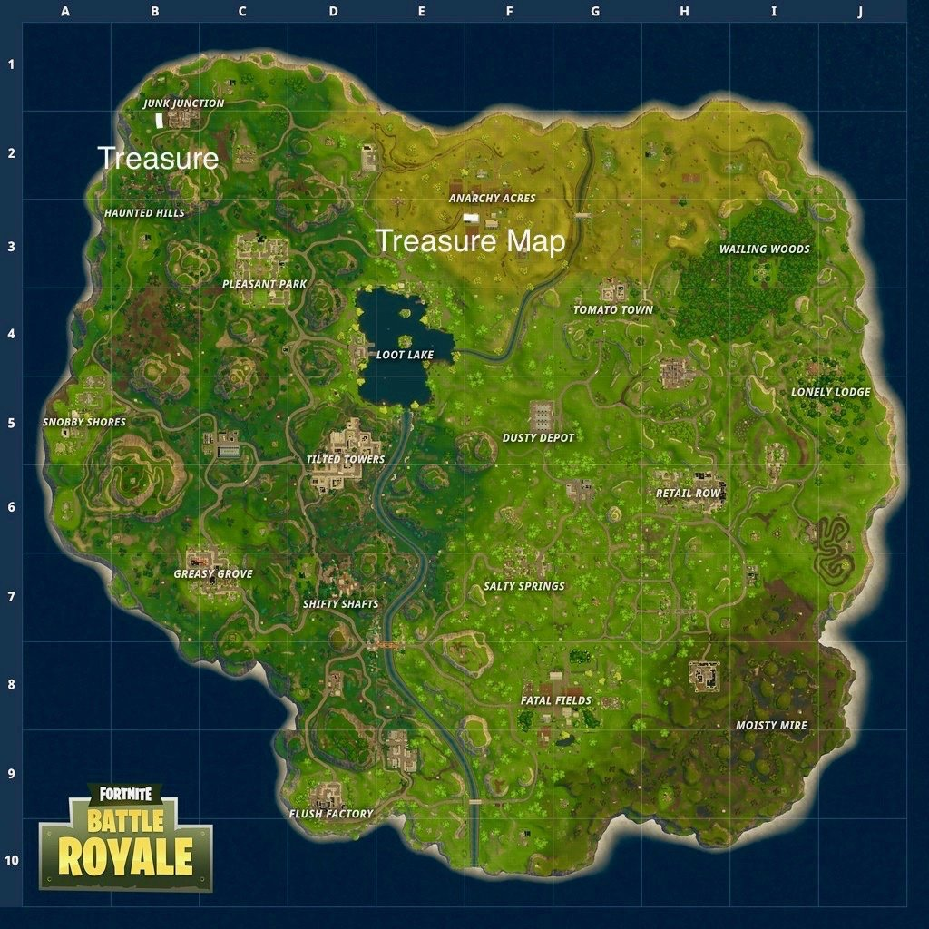
Where it happend
Living room
Old Xbox
In my house
Next to my parents
Anarchy acres

Slide 9
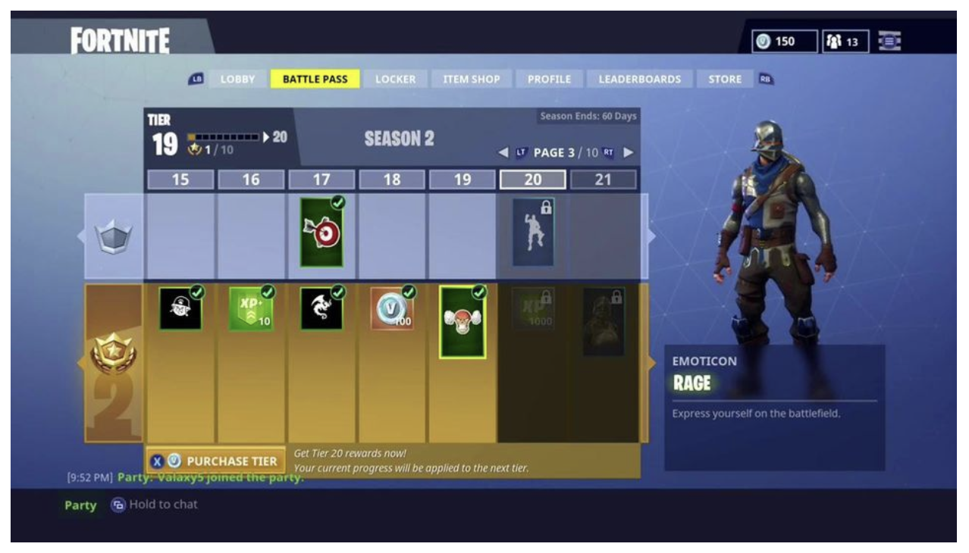
What others thought about it
Very happy
Wanted to see proof
Joined my Party Chat
Battle pass
(Once obtained, the battle pass presents the player with a number of reward tiers; by earning enough experience to complete the tier, the player gains the rewards offered at that tier.
950 vbucks or 9,99 Dollar)

Slide 10

End

